Slide 1

Buffer

Slide 2
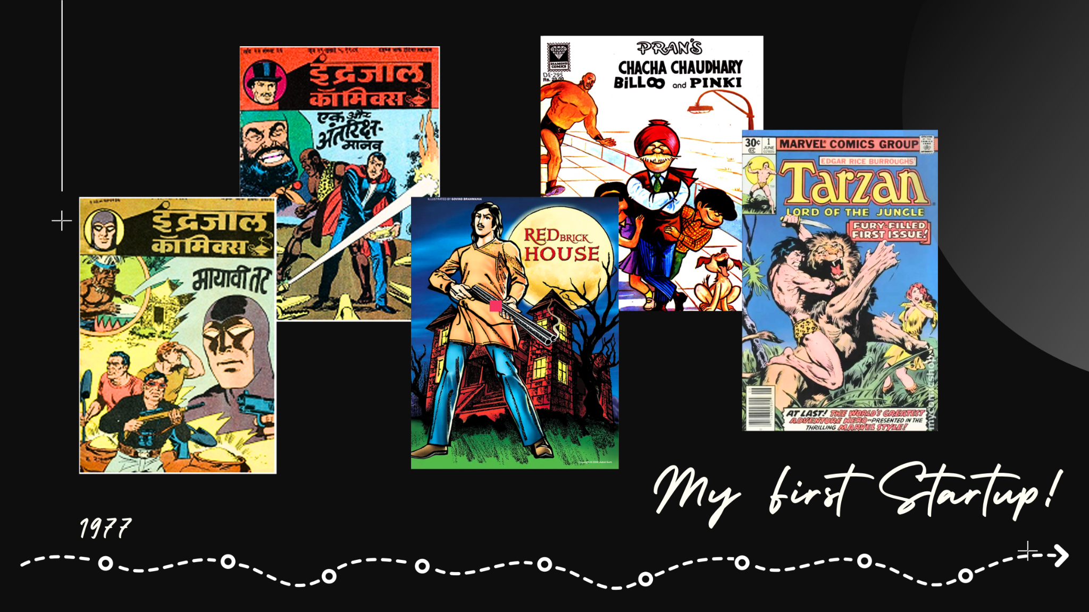
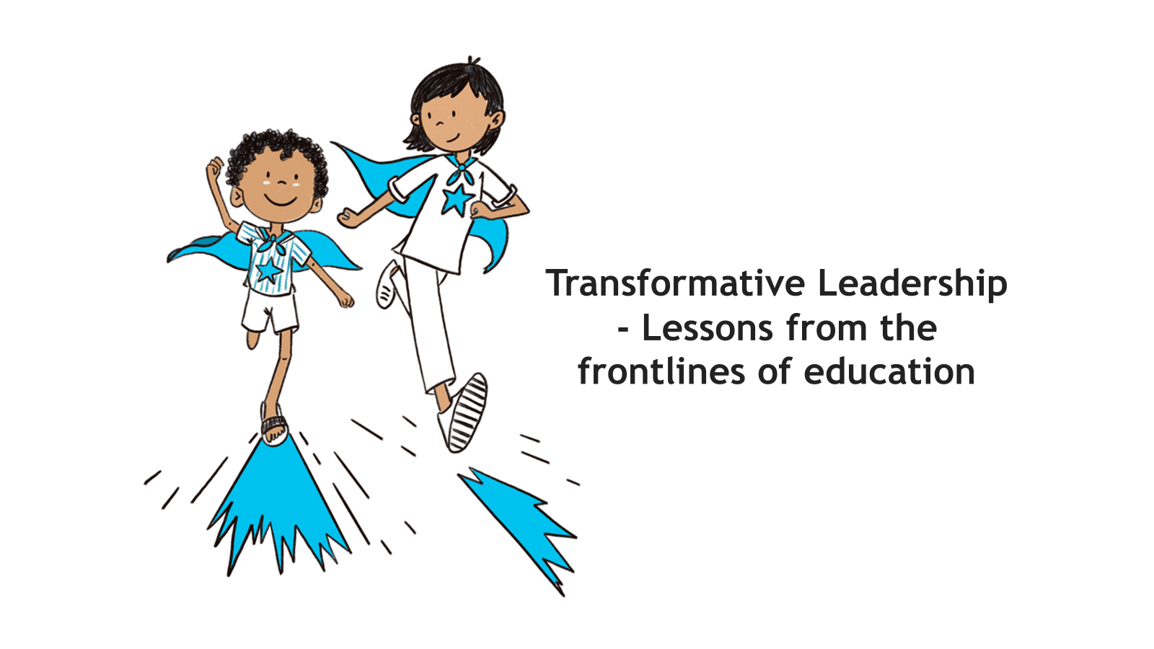

Slide 3
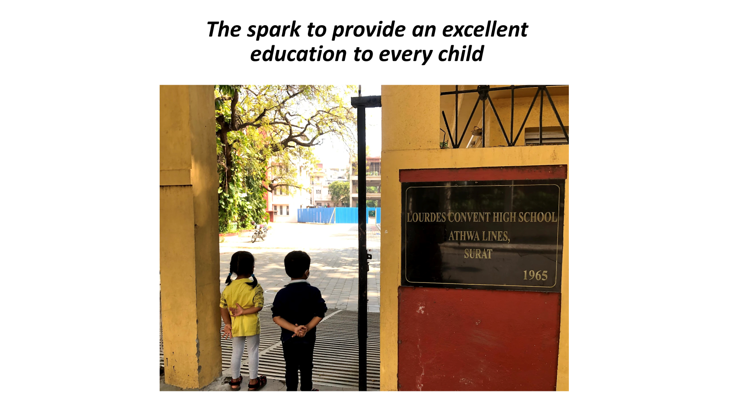

Slide 4


Slide 5
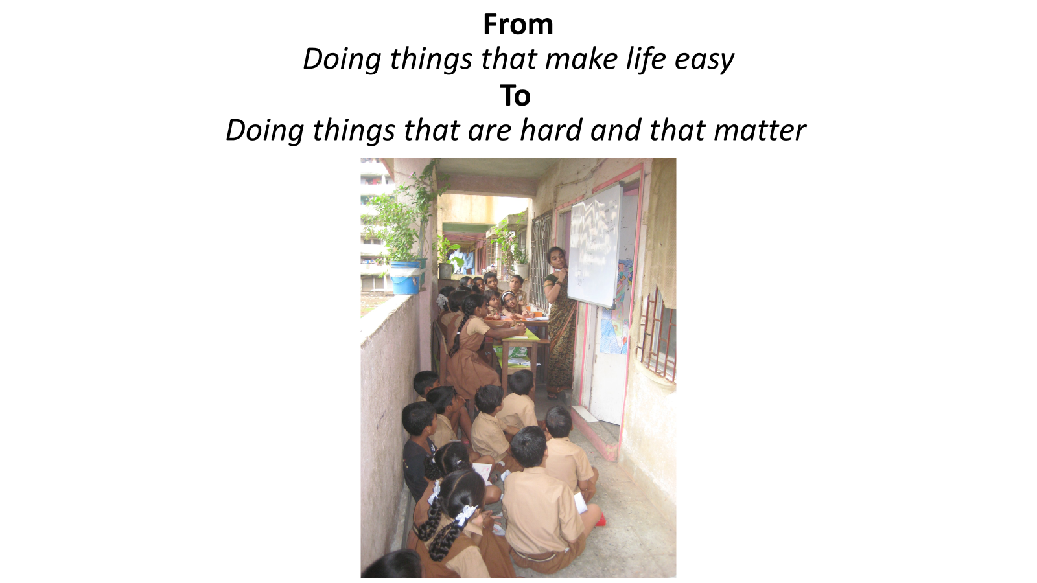

Slide 6
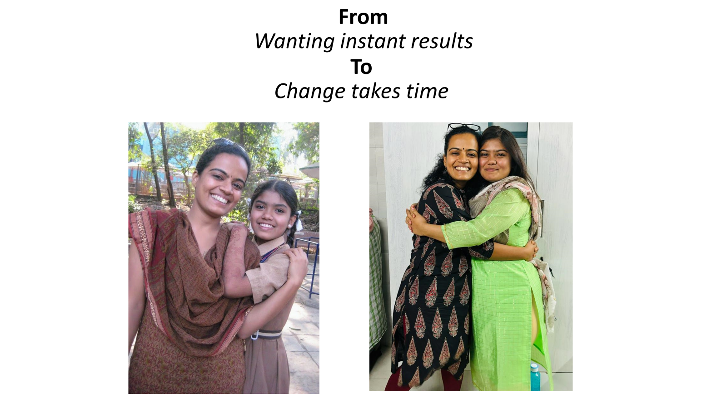

Slide 7


Slide 8
Buffer

Slide 9
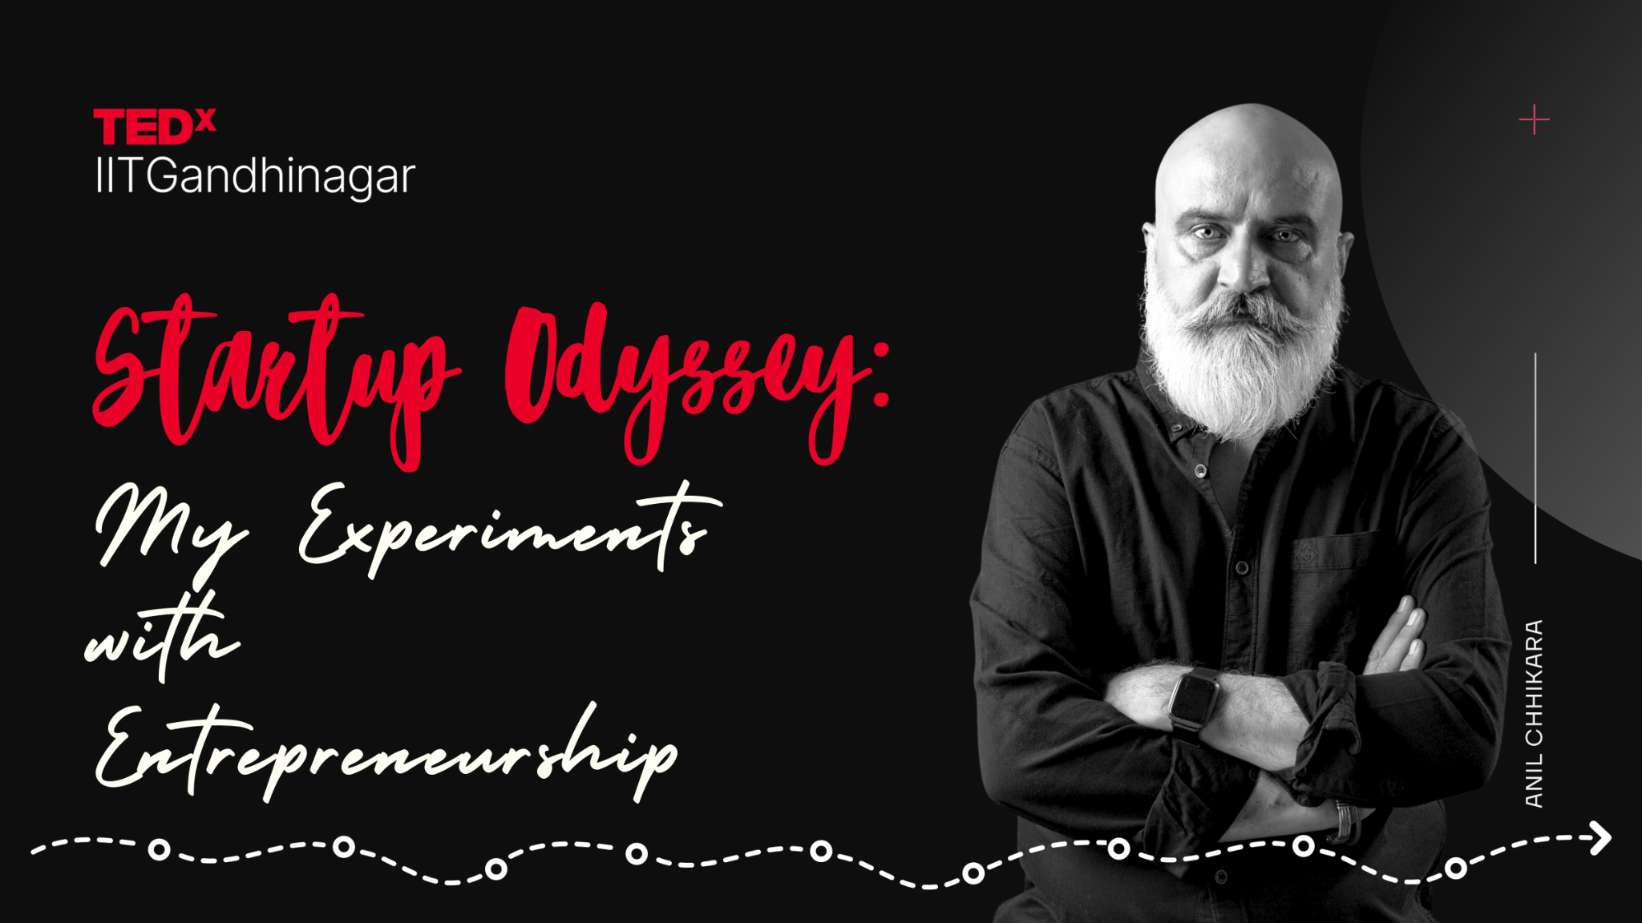

Slide 11
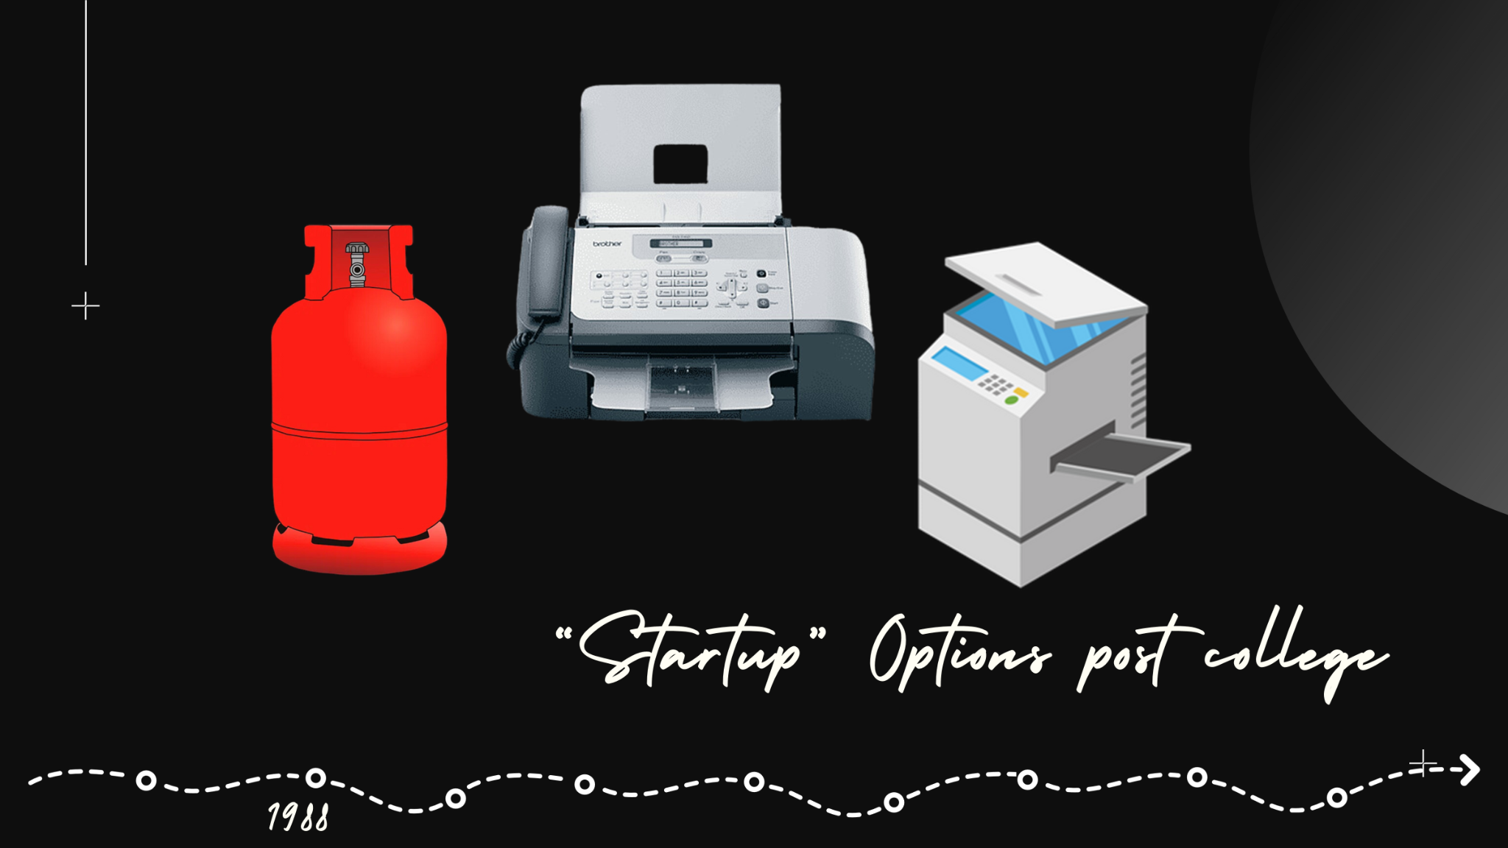

Slide 12
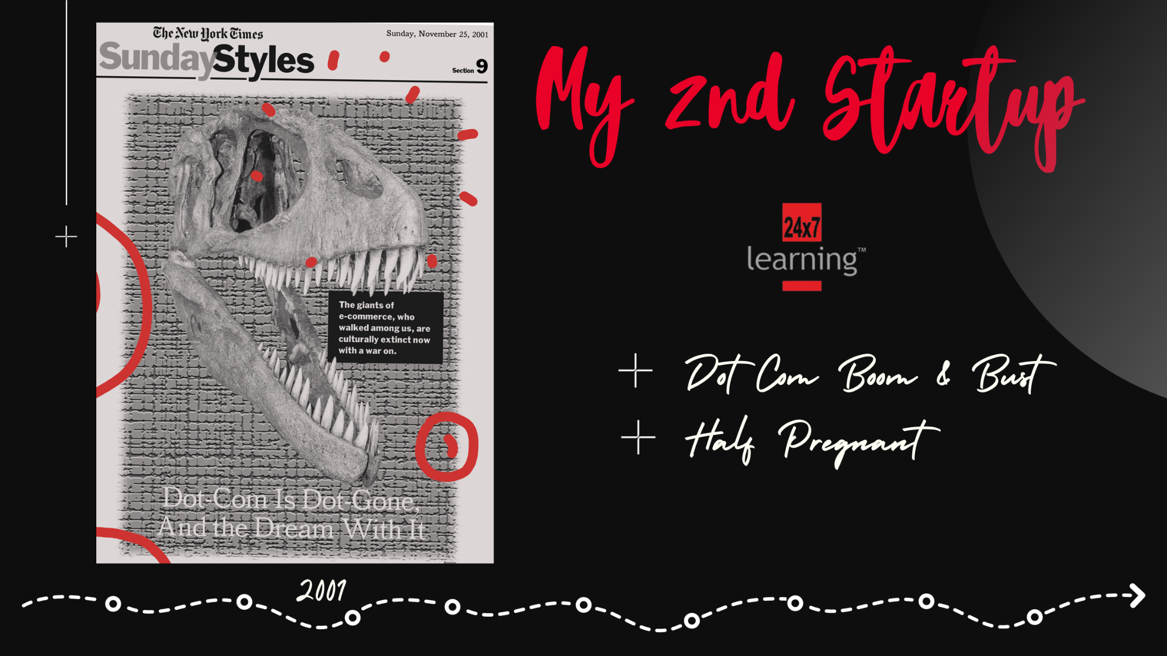

Slide 13
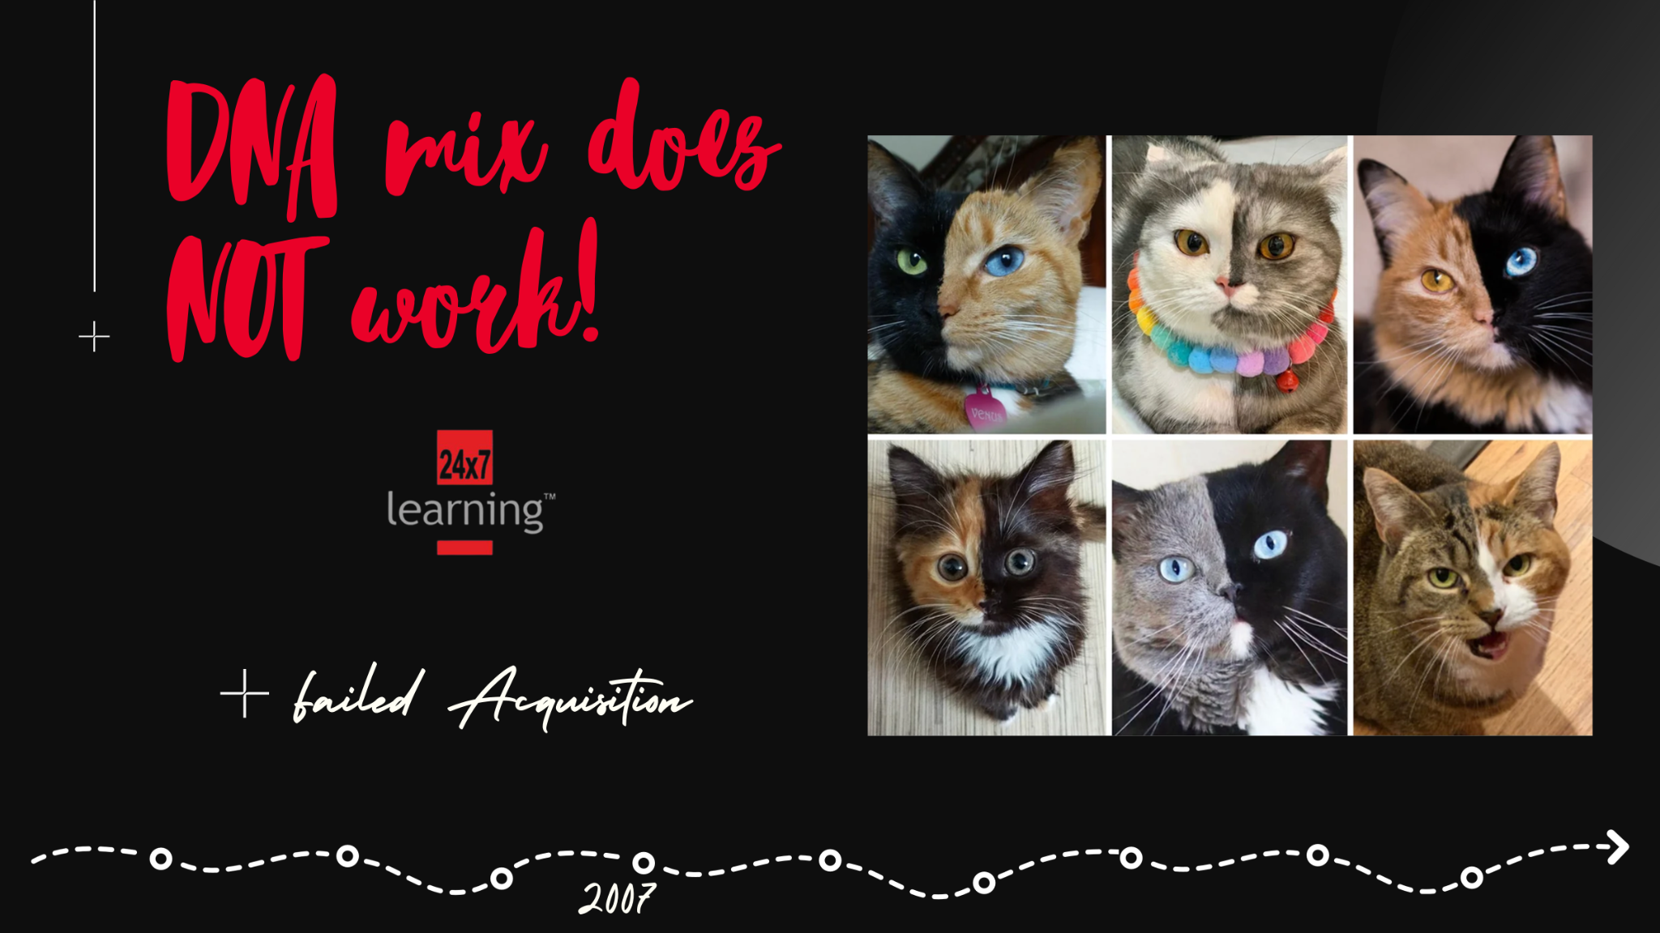

Slide 14


Slide 15


Slide 16


Slide 17


Slide 18


Slide 19


Slide 20


Slide 21
Buffer

Slide 22



Slide 23
Henry Adams - " chaos was the law of nature, order was the dream of man”

Slide 24
“ADM Jabalpur & Ors. v. Shivkant Sukla”
JUSTICE H.R KHANNA VIEWS in a purely formal sense, any system of norm based on a hierarchy of orders, even the organised mass murders of Nazi regime qualify as law. This argument cannot however, disguise the reality of the matter that hundreds of innocent lives have been taken because of the absence of rule of law

Slide 25
LAW VS RULE OF LAW
EQUALITY, FAIRNESS, ACCESS TO JUSTICE, INDEPENDENT JUDICIARY

Slide 26
Realise it or not all aspects of your life are governed by laws- birth to death, business to profession, personal life to public life- (death, taxes, laws)

Slide 27
ONE TEST CASE
Law changes SOCIETY FUNDAMENTALLY in Jammu & Kashmir-
MARRIED OUTSIDE J&K
A key provision of Article 35A3 forbidding non-Kashmiris from outside the state from permanently settling, buying land, holding local government jobs, and securing education scholarships had, however, remained

Slide 28
ARTICLE 370 ABROGATION LAW
1)Integral part of India vs Part of India because of Article 370, Azad Kashmir
2)2 constitutions, 2 flags etc
●

Slide 29
PROPERTY RIGHTS OF WOMEN RESTORED, THEIR NON-RESIDENT SPOUSES MADE ELIGIBLE FOR DOMICILE

Slide 30
DOMICILE RULE AND CENTRAL LAWS NOW EXTEND TO JAMMU AND KASHMIR
PROBLEMS:-
One, it is noteworthy that before August 2019, if a Jammu and Kashmir woman married a man from outside the state, she could no longer buy property there. Their husbands weren’t considered to be from Jammu and Kashmir, so they couldn’t inherit or buy property there either. Thus, it ended up jeopardising women’s rights as it barred their freedom to choose a life partner

Slide 31
•PROBLEMS OF SC/ST
Forget Government jobs, their children were not able to do technical or professional courses in any Government institute because they had to participate in entrance eligibility test before doing any such course, and for this they required PRC.
The biggest surprise was that these people could vote in the Lok Sabha Elections but could not choose the Government of the State.
graduate degrees, they had no other options but to stick to cleaning jobs.
Radhika Gill and Eklavya

Slide 32
INITIATIVES BY CENTRAL GOVERNMENT:-
Persons with Disabilities Act, 2016:-
The Rights of Persons with Disabilities Act, 2016 is a disability law passed by the Parliament of India to fulfil its obligations under the United Nations Convention on the Rights of Persons with Disabilities, ratified by India in 2007.[1] The Act replaces the Persons with Disabilities (Equal Opportunities, Protection of Rights and Full Participation) Act, 1995

Slide 33
INITIATIVES BY CENTRAL GOVERNMENT:-
National Commission for Safai Karamcharis Act 1993:
The National Commission for Safai Karamcharis Act, 1993, establishes a commission to safeguard the welfare and rights of sanitation workers in India.

Slide 34
INITIATIVES BY CENTRAL GOVERNMENT:-
The Scheduled Castes and Scheduled Tribes (Prevention of Atrocities) Act, 1954
The Scheduled Castes and Scheduled Tribes (Prevention of Atrocities) Act, 1954, aims to prevent atrocities against individuals belonging to Scheduled Castes and Scheduled Tribes and provide legal mechanisms for their protection.

Slide 35
INITIATIVES BY CENTRAL GOVERNMENT:-
The National Commission for Minorities Act, 1992
The National Commission for Minorities Act, 1992, establishes a commission to safeguard the rights and interests of religious and linguistic minorities in India.

Slide 36
INITIATIVES BY CENTRAL GOVERNMENT:-
The Indecent Representation of Women (Prohibition) Act, 1996
The Indecent Representation of Women (Prohibition) Act, 1996, prohibits the portrayal of women in an indecent or derogatory manner in various forms of media.

Slide 37
INITIATIVES BY CENTRAL GOVERNMENT:-
The Protection of Human Rights Act, 1993
The Protection of Human Rights Act, 1993, establishes commissions to address violations and promote awareness of human rights issues in India.
And many more…..

Slide 38
WOMEN VOTING RIGHT MOVEMENT IN UK
First public meeting at the Manchester Free Trade Hall on 14 April 1868. it was rare for women to speak publicly at this time.
Filestone was achieved in 1928 with the Representation of the People (Equal Franchise) Act whereby voting rights were granted to all women over the age of 21, signalling the first time that women had achieved electoral equality with men.

Slide 39
Hindu Woman’s Right after Hindu Succession (Amendment) Act, 2005
The Amendment of 2005
Prior to the Hindu Succession Amendment Act 2005, sons enjoyed rights over the deceased father’s property, whereas daughters could do so only till she was unmarried. After it Now married women could inherit their father’s property which was previously only enjoyed by the male members of the family.

Slide 40
WOMEN VOTING RIGHT MOVEMENT IN USA
In 1848, the movement for women’s rights launched on a national level with the Seneca Falls

Slide 41
SOCIAL MEDIA
•FBI DIRECTOR
•TIKTOK
•OTT
•FINES

Slide 42
ARTIFICIAL INTELLIGENCE
Nothing is certain except death and taxes - This famous quote about taxes originated with Benjamin Franklin in 1789.
•CASE ON AI

Slide 43
Aristotle: "at his best. man is the noblest of all animals; separated from law and justice he is the worst"

Slide 44
Buffer

Slide 45
Innovative Biomedical Technologies to Impact Healthcare

Slide 46
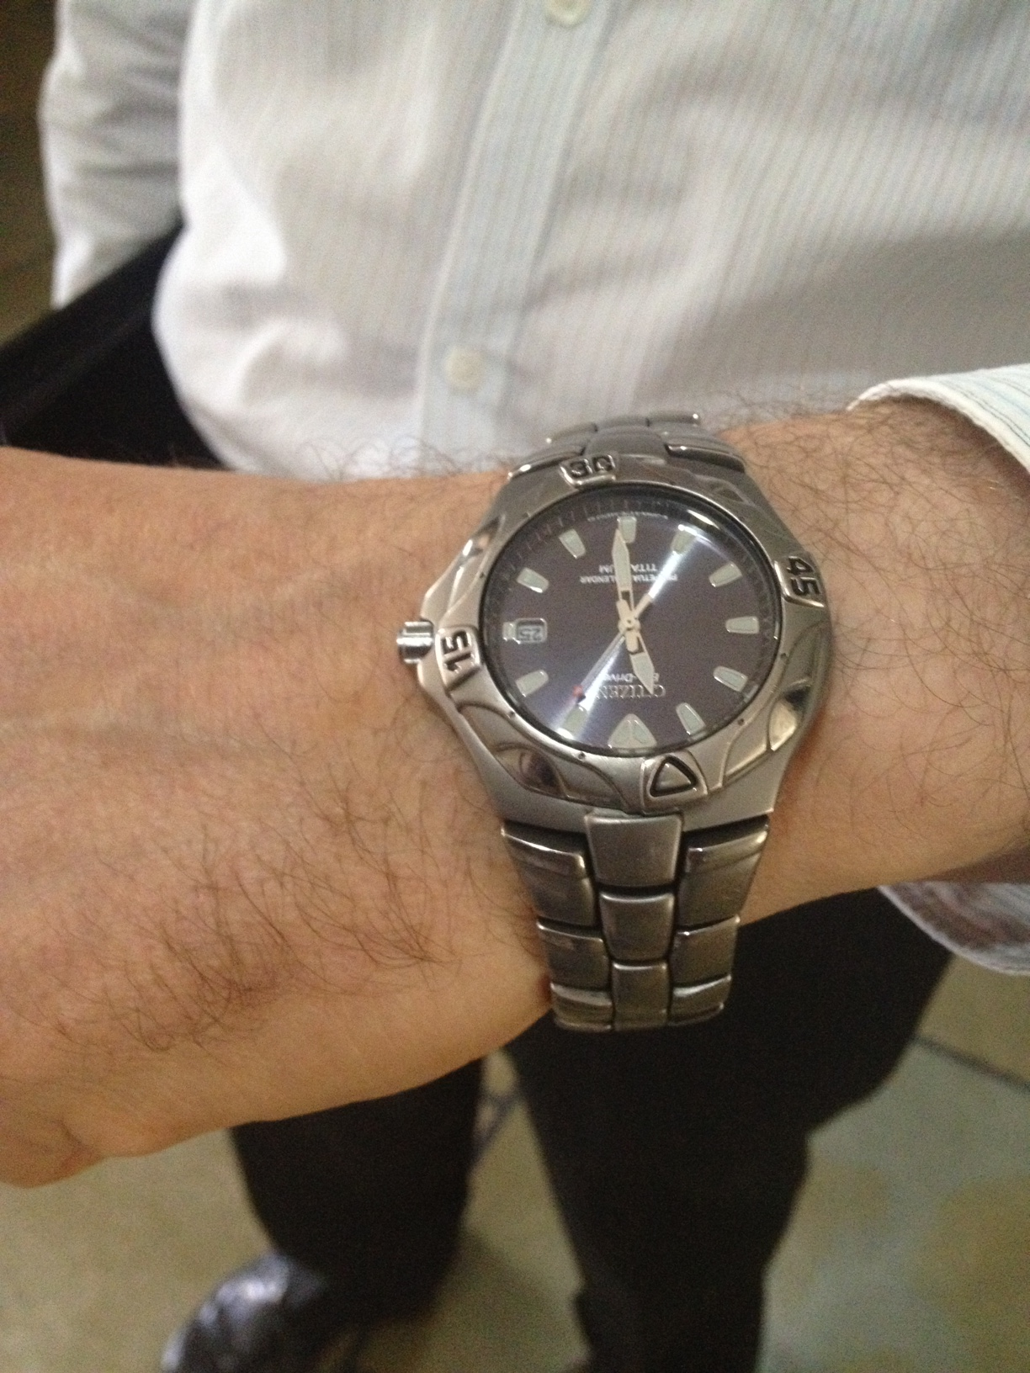
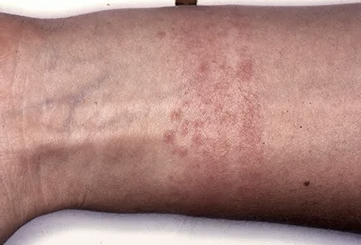
Contact Dermatitis
Credit: Vemula

Slide 47
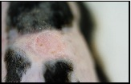
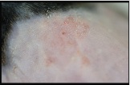
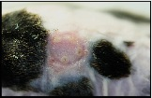
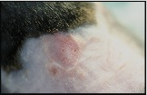
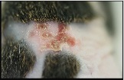
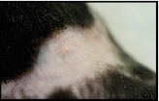
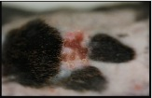
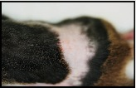
Without Cream
With Cream
Day 1
Day 2
Day 4
Day 5
Credit: Vemula / Nature Nanotechnology (2011)

Slide 48
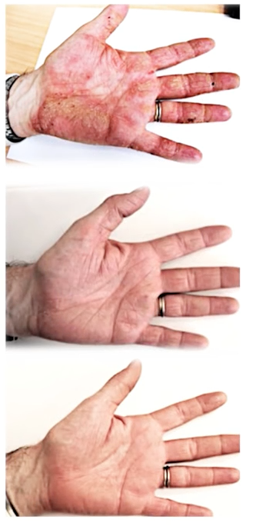
Week 0
Week 2
Week 32
Credit: Vemula

Slide 49

Credit: Vemula

Slide 50
Vision
Creative thinking
Grit

Slide 51
Industry / Academia

Slide 52
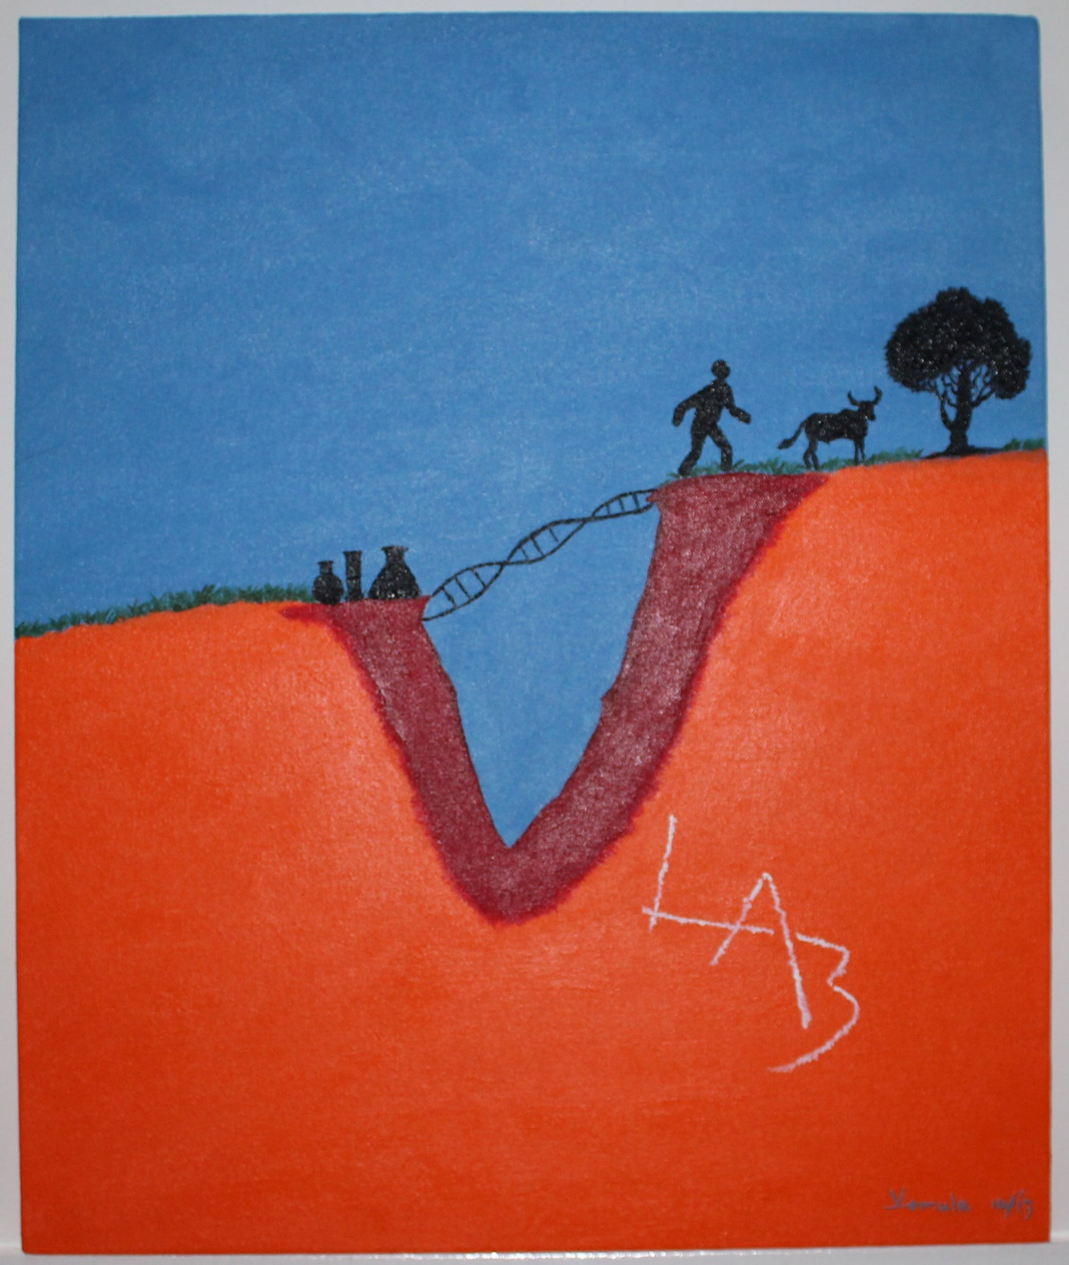
Credit: Vemula

Slide 53
Identifying the unmet need
Developing innovative technology

Slide 54
Me Too technologies
Me Better technologies
Me Only technologies

Slide 55
Medical Textiles
Drug Discovery
Drug Delivery
Medical Devices
Credit: Vemula

Slide 56
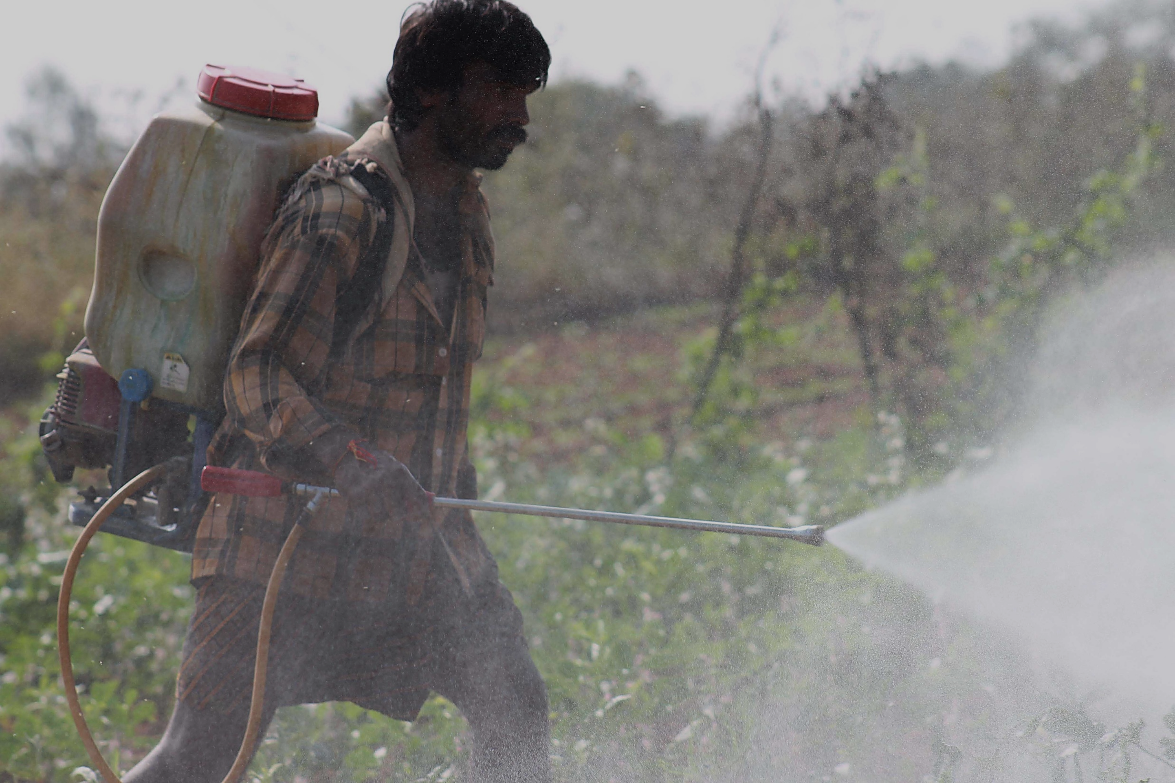
Credit: Vemula

Slide 57
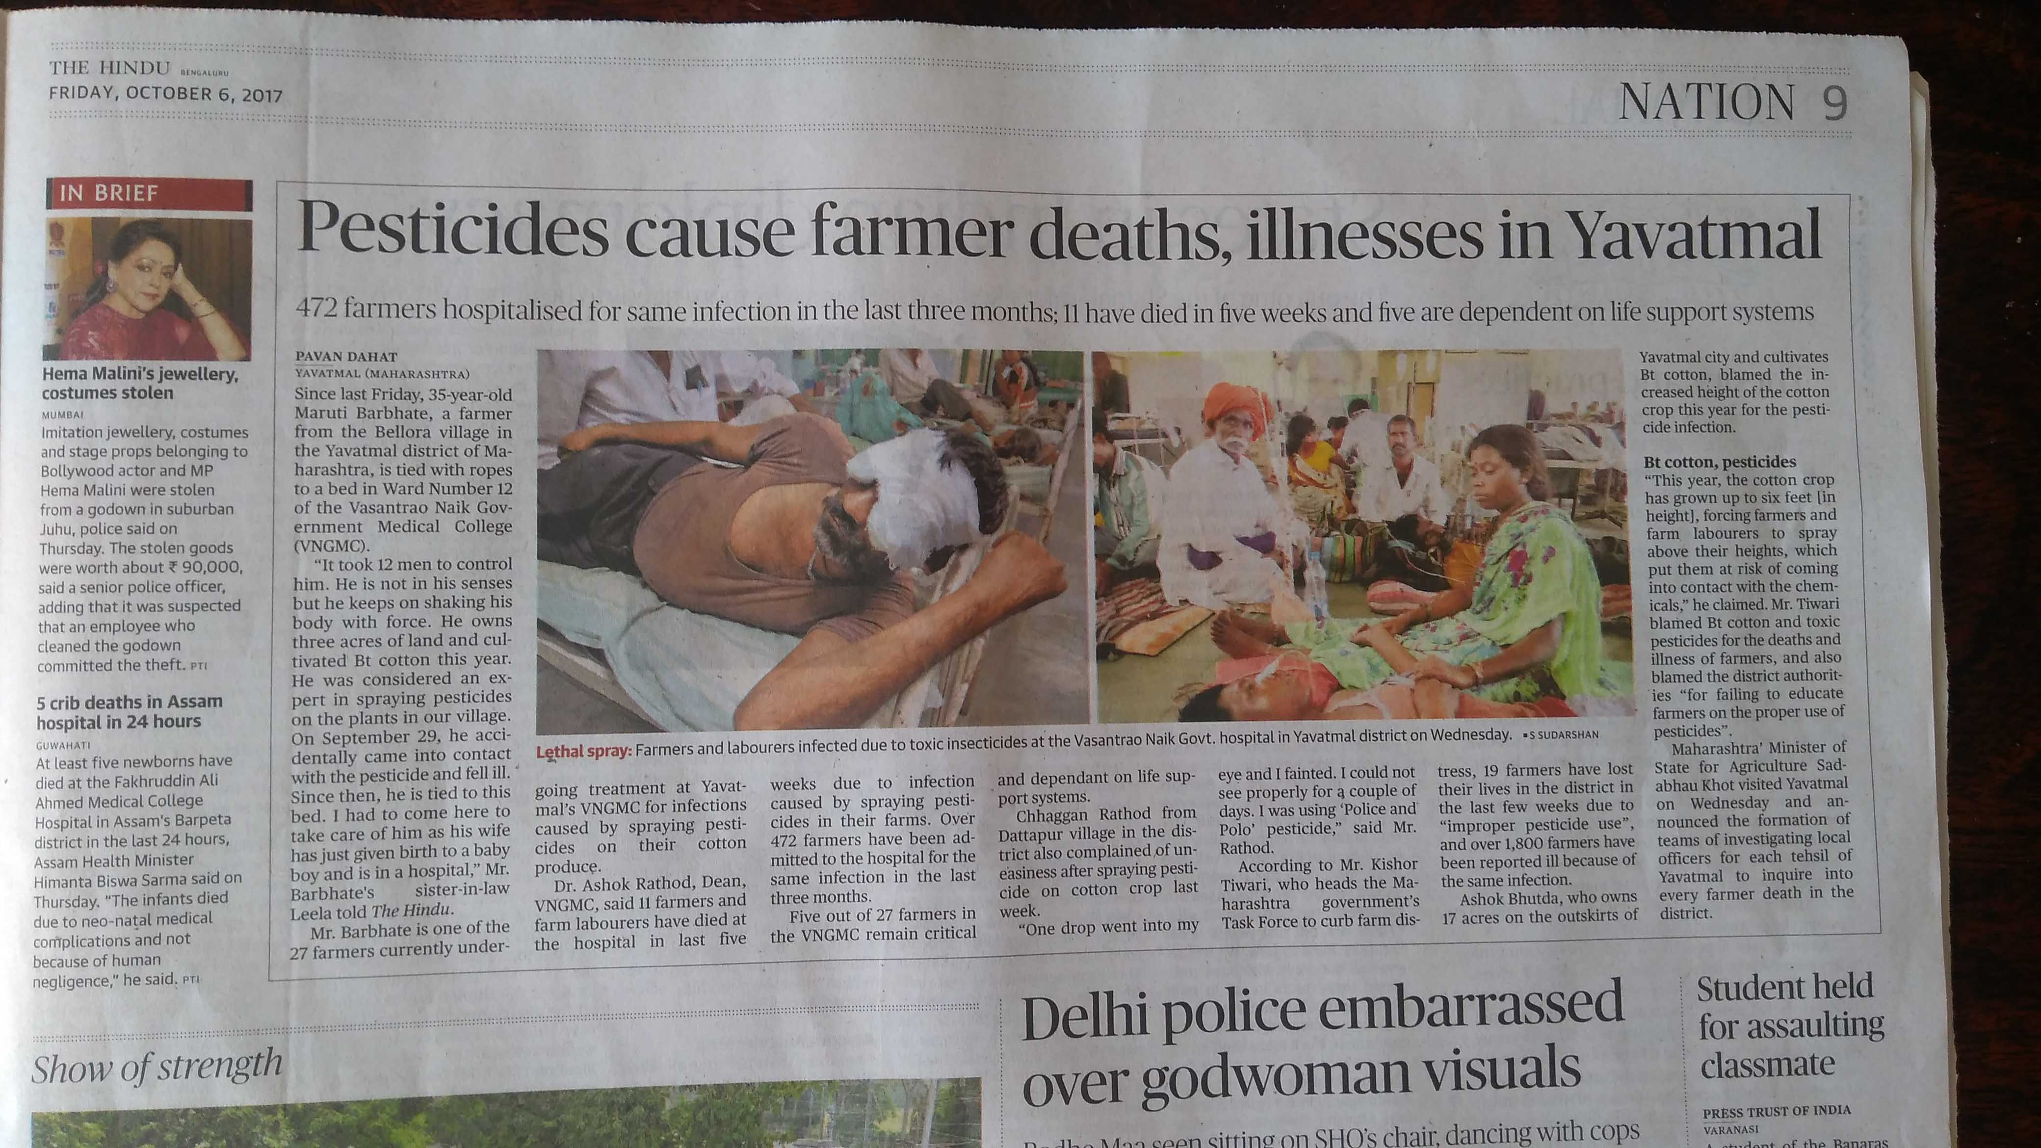

Slide 58
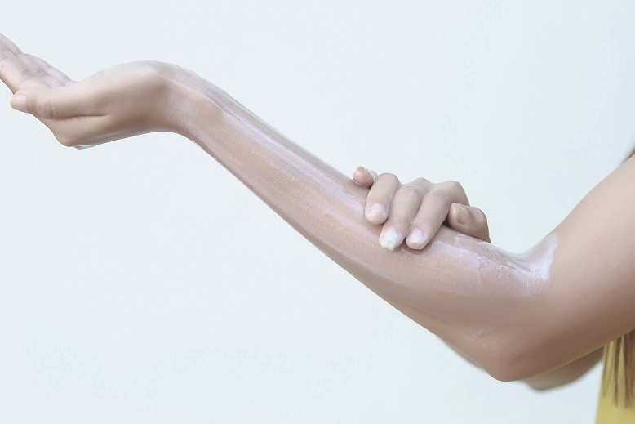
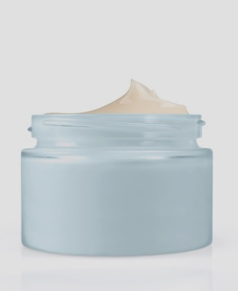
Anti-Pesticide Cream
Credit: Vemula / Science Advances (2018)

Slide 59
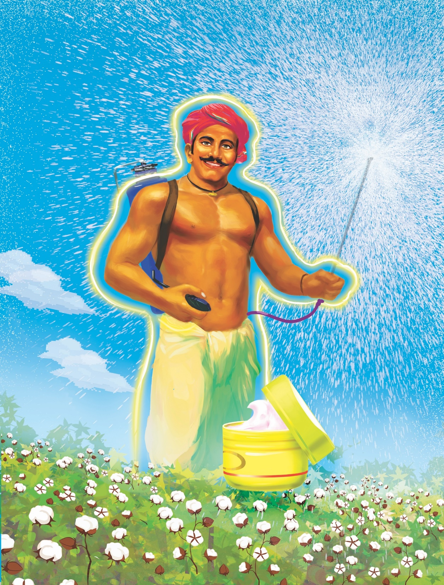
Credit: Vemula

Slide 60


Anti-Pesticide Fabric
Credit: Vemula

Slide 61

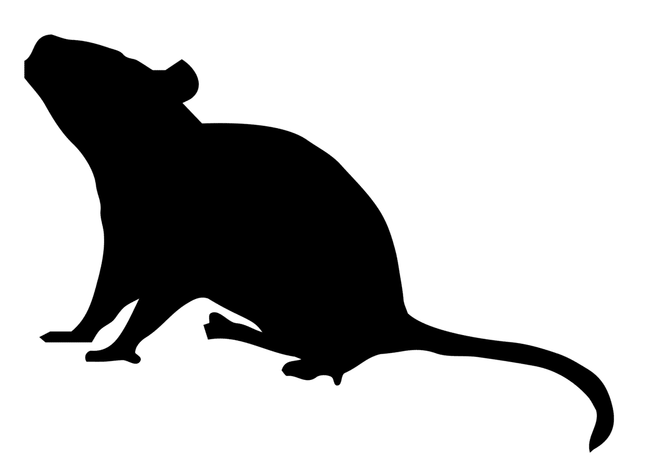
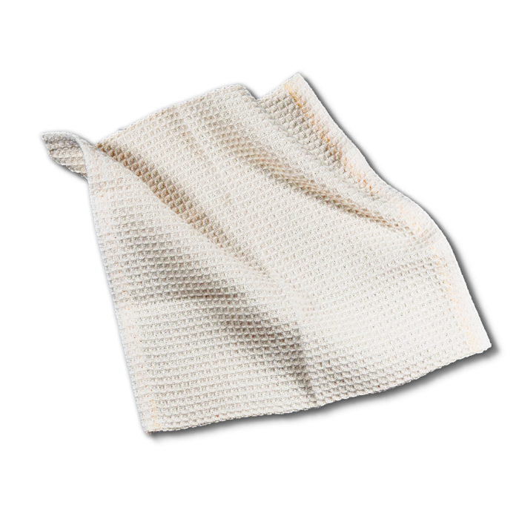

Normal Fabric
0% survival
EPx
Anti-Pesticide Fabric
100% survival
EPx
Credit: Vemula / Nature Communications (2024)

Slide 62
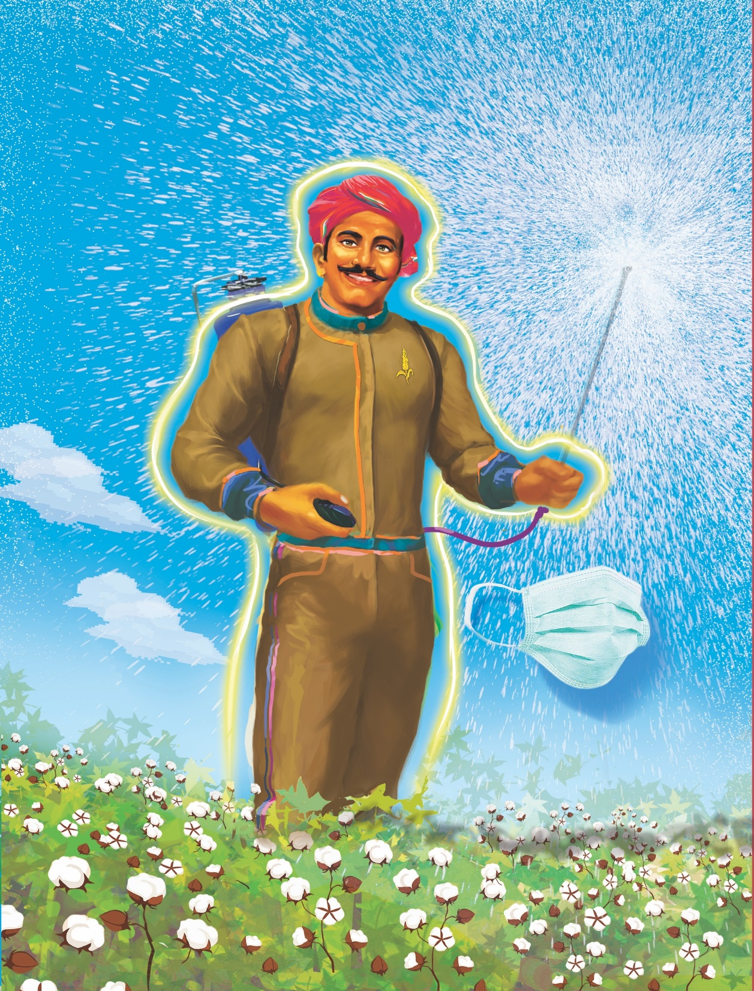
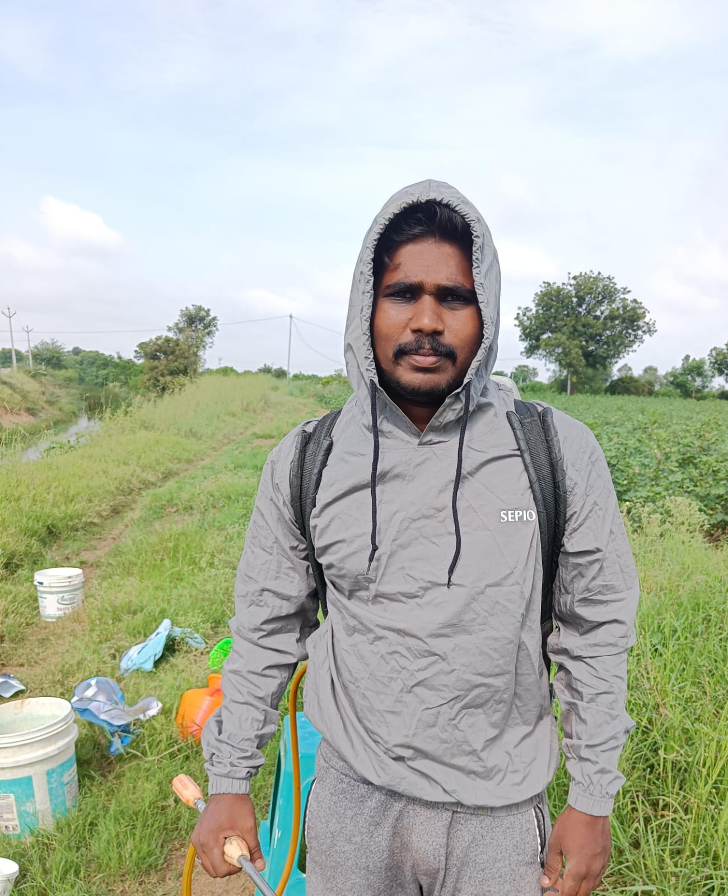
Kisan Kavach
®
Credit: Vemula

Slide 63
Germicidal Fabric to prevent infections

Slide 64
Credit: Google images

Slide 65
N95
Surgical Mask
Cloth Mask

Slide 66
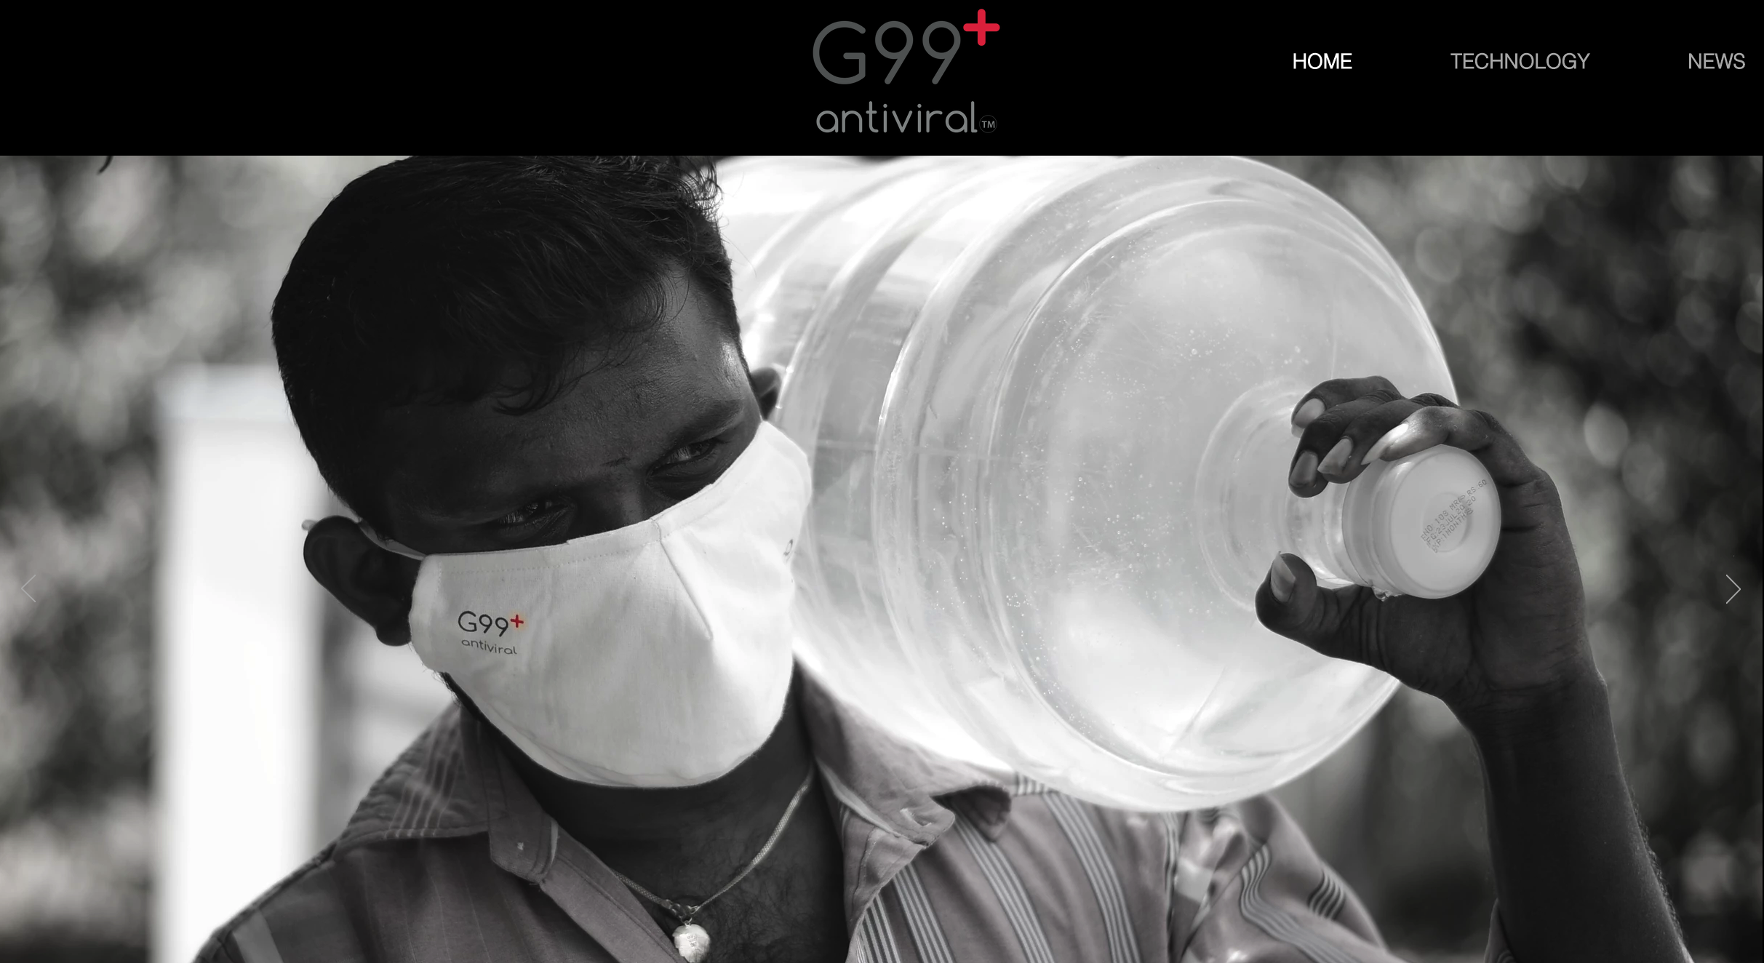
Credit: Vemula

Slide 67
Drug Discovery: for Ulcerative Colitis

Slide 68
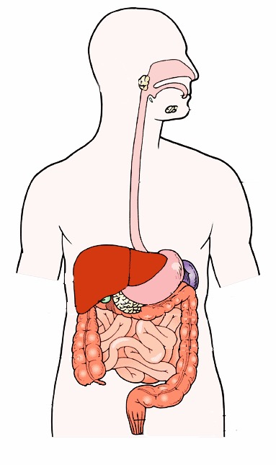
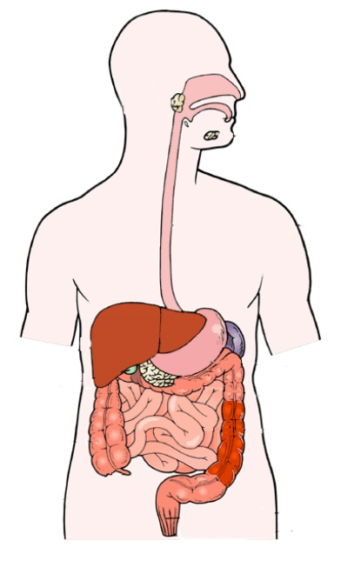
Healthy
Colitis
Tight Junction Proteins
Leaky gut
No inflammation
Barrier repair
Increased
Inflammation
Credit: Vemula / Nature Communications (2019)

Slide 69
Drug Delivery: Disease Targeted Delivery

Slide 70
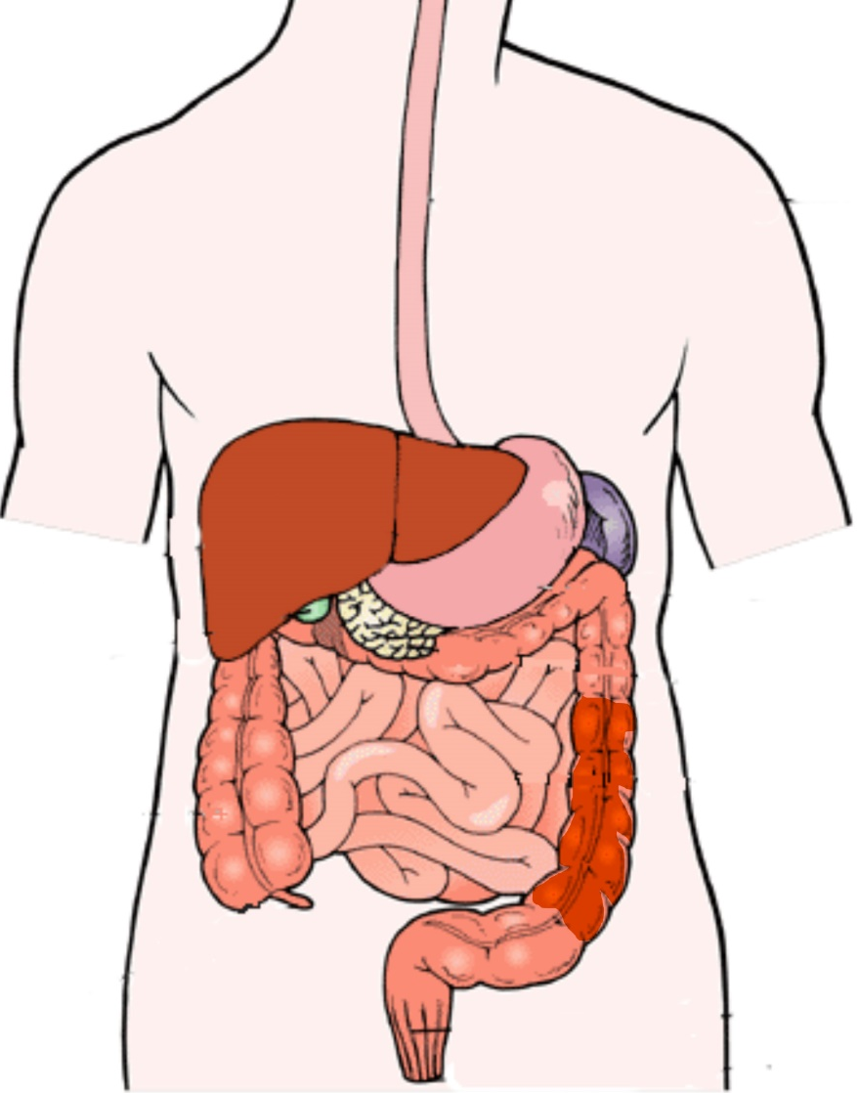
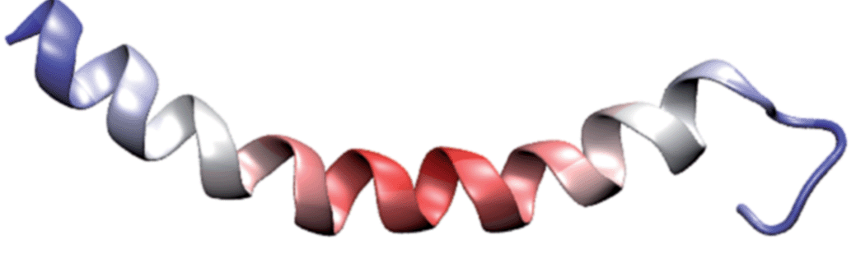
Inflammation targeting nanomaterials
-
-
-
-
+
+
+
+
+
+
+
+
Credit: Vemula / Science Transl. Medicine (2015)

Slide 71
Novel Blood Bags to enhance the quality and shelf-life of stored blood

Slide 72
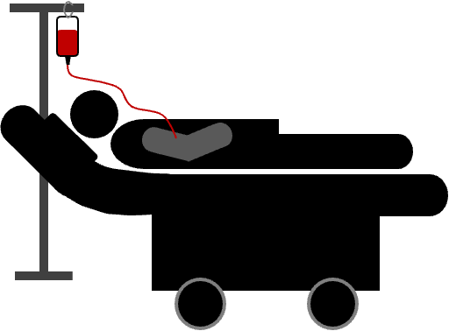
Credit: Vemula

Slide 73



DAMPs
DNA
+
Nucleosomes
21 days
42 days
+
PUFAs
Safe to transfusion
Quality decreases
Iron (Fe)
Heme
Credit: Vemula / Nature Communications (2022)

Slide 74


Bad quality blood
Credit: Vemula / Nature Communications (2022)

Slide 75
Bad quality blood
Good quality blood
Credit: Vemula / Nature Communications (2022)

Slide 76
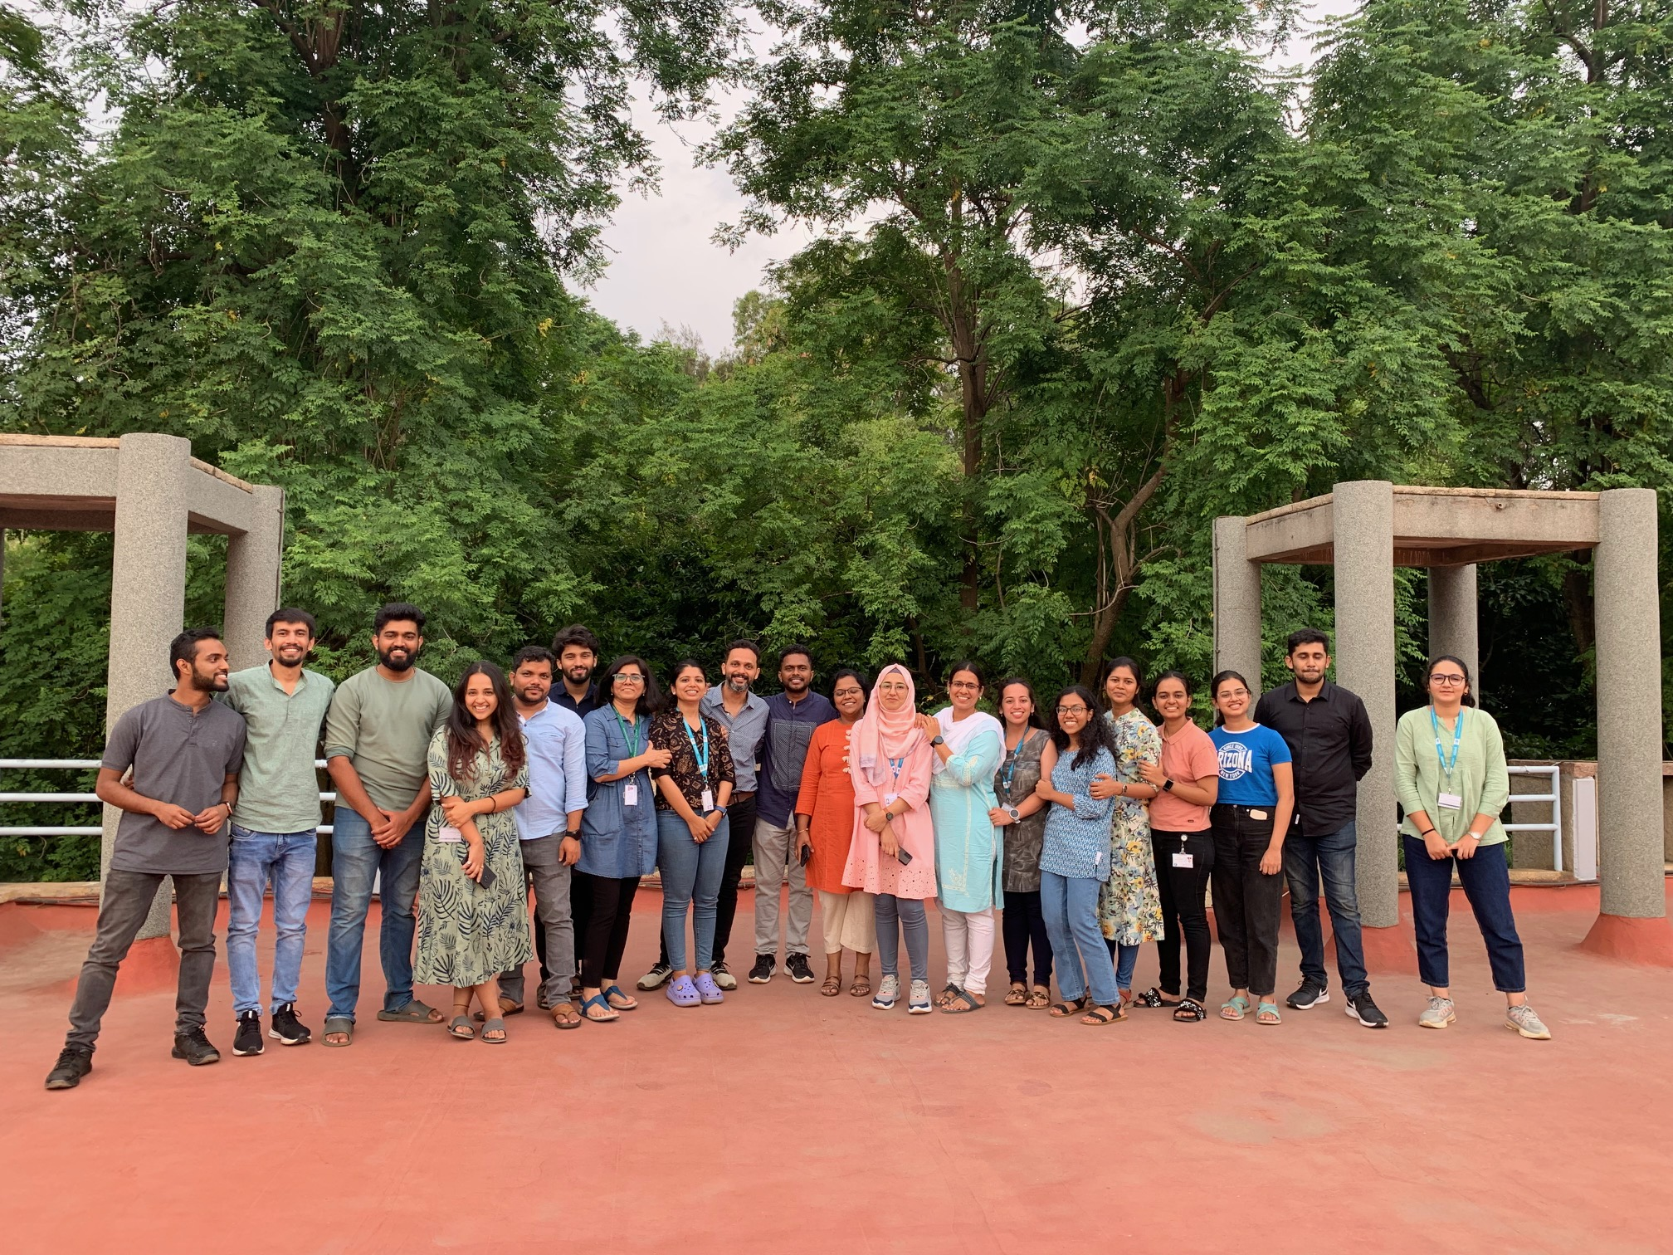

Credit: Vemula

Slide 77
Buffer

Slide 78
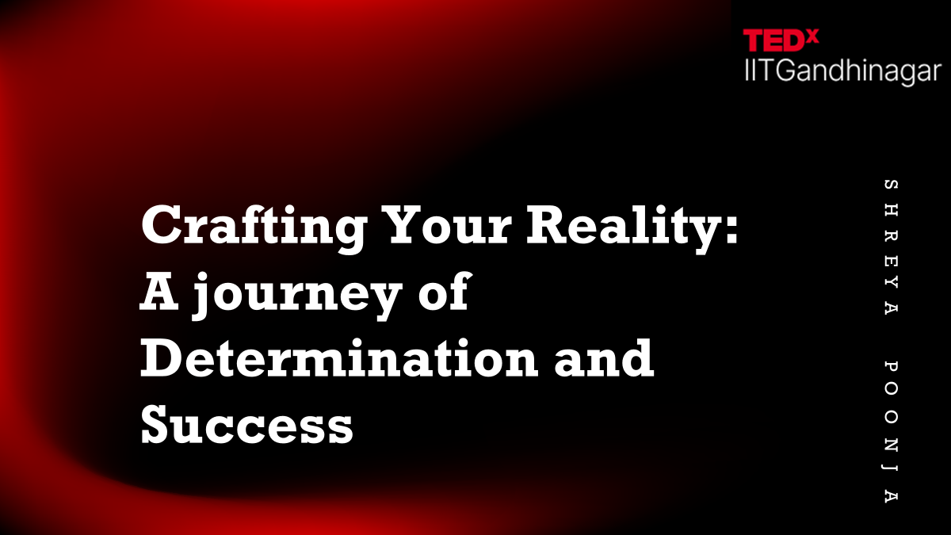

Slide 79


Slide 80


Slide 81


Slide 82


